Slide 1
Assignment 3

Slide 2
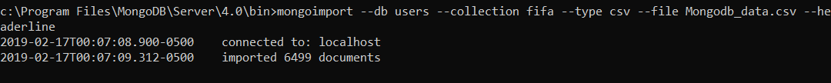
How you create your database and collection(s) (your code and the corresponding screenshots)
Answer:

Slide 3
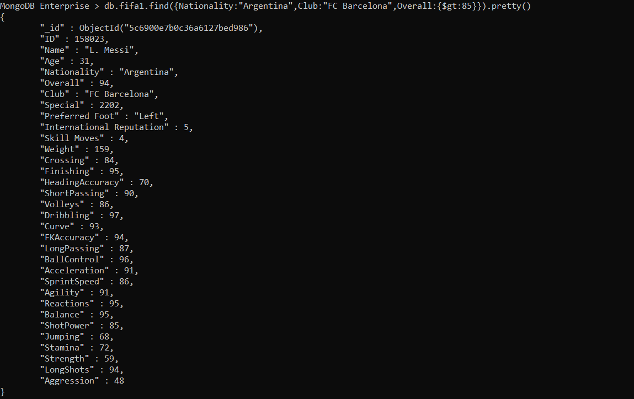
Query 1 Find the details of the player whose nationality is Argentina and club is FC Barcelona with overall Rating > 85

Slide 4
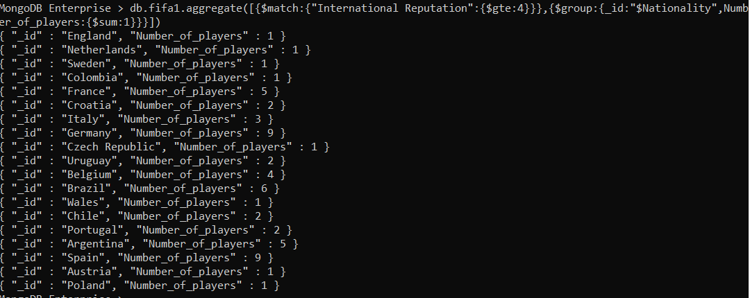
Find the number of players per country with international reputation >=4
Query 2

Slide 5
Find the number of players whose nationality is Germany or England, preferred foot is Right and age is less than 40
Query 3

Slide 6
Top 2 players of club FC Barcelona on the basis of overall rating and have ball control greater than 90.
Query 4

Slide 7
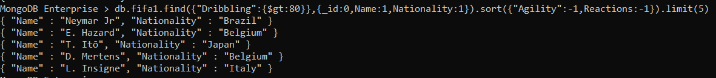
Display the name and nationality of the top 5 players ordered by agility then by reaction with dribbling rate greater than 80
Query 5

Slide 8
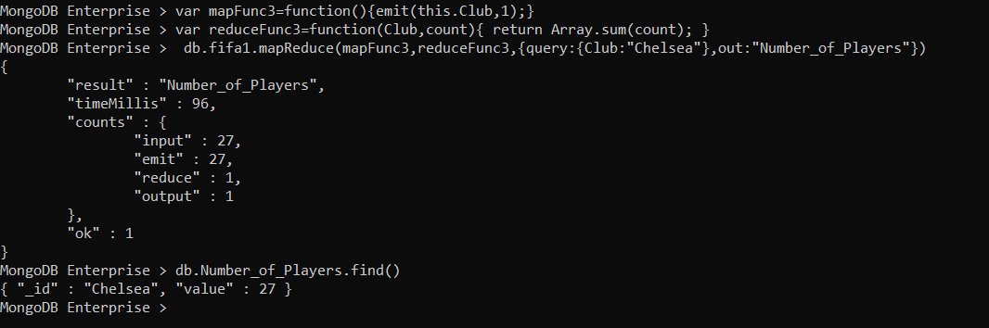
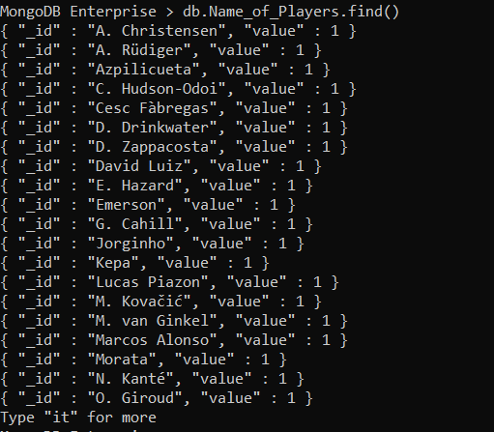
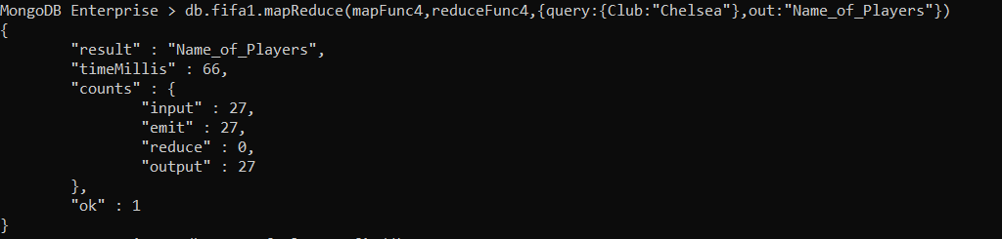
Find the number and name of players who played for Club :chelsea
Query 6

Slide 9
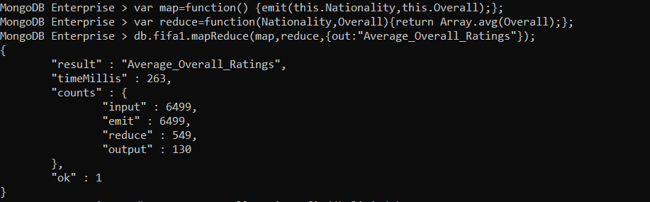
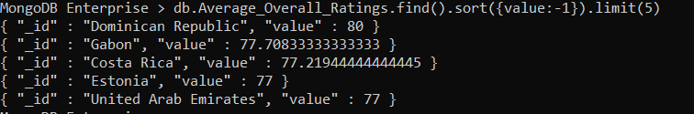
Find the top 5 countries having highest average overall player rating.
Query 7

Slide 10
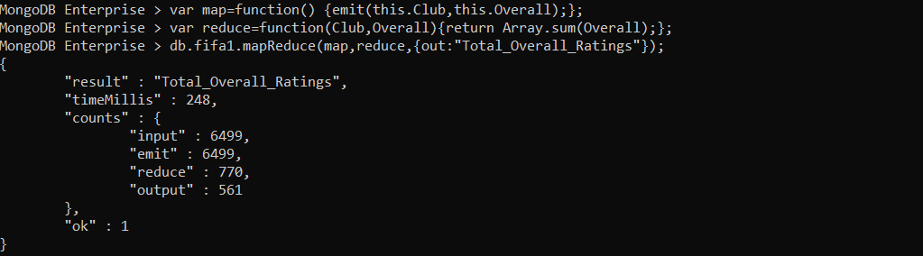
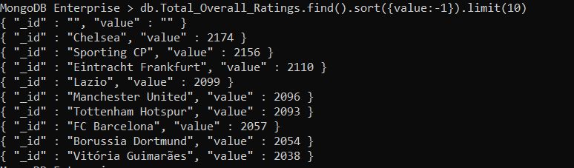
Find the top 5 clubs having highest overall player rating
Query 8
Find the top 10 clubs having highest total overall player ratings

Slide 11
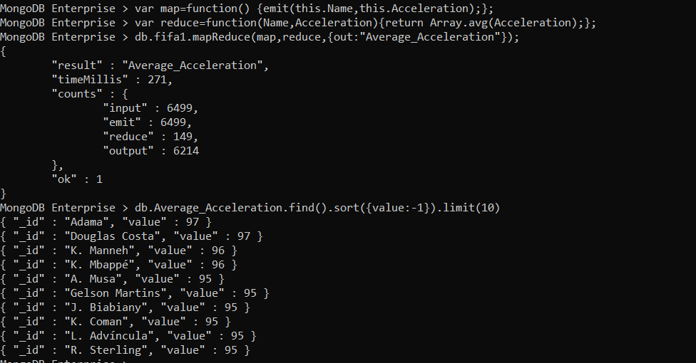
Find the top ten players having highest Acceleration
Query 9

Slide 12
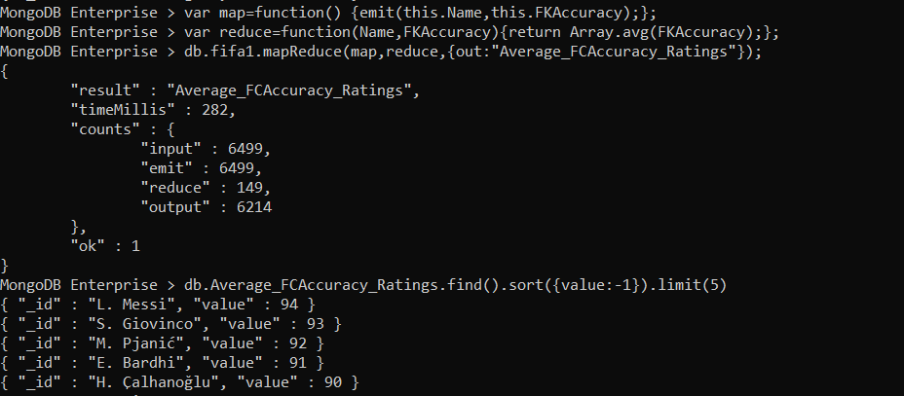
Query 10
Find the top 5 players having highest FCAccuracy Ratings

